Slide 1
MoneyMate
Your Finances, Simplified and
Organized! Powered by AI.

Slide 2
Agenda:
01
06
02
03
04
05
Motivation
Artificial Intelligence
Problem
07
System Design
Solution
08
BACKEND
Market Analysis
09
FRONTEND
TOOLS
10
DEMO

Slide 3
Motivation:
MoneyMate is a simple and effective mobile app that helps users manage their daily expenses with ease. The app allows you to record spending, categorize transactions, set monthly budgets, and view visual summaries — all through a clean and user-friendly interface.
To make tracking even easier, MoneyMate uses AI to automatically recognize expenses from SMS message and scanned receipts, saving your time and reducing manual input. Whether you're just starting to budget or want a smarter way to stay in control, MoneyMate helps you manage your money effortlessly.

Slide 4
Problem:
• Lack of awareness
• Traditional methods complexity
• Limited personalized insights
• Small or Irregular Expenses

Slide 5
Solution:
• Real-Time Spending Insights
• OCR receipt recognition
• Sms auto recognition
• Quick Add Functionality

Slide 6
04
Market Analysis

Slide 7
Market Overview:
• People want easy ways to manage money using their phones.
• The personal finance app market is growing fast.
• More people are becoming interested in budgeting, saving, and controlling spending.

Slide 8
Target Audience:
• Age: 16–45 years.
• Students, young professionals, and middle-income earners.
• Tech-savvy, prefer mobile-first solutions.
• Concerned about budgeting, and tracking daily spending.

Slide 9


Our Competitors:
YNAB
Spendee

Slide 10
What Makes Us Different:
• User-Friendly Interface:
Clean, modern design that’s easy for beginners to use.
• Flexible & Easy Expense Entry:
Multiple easy ways to add expenses — manual, scan recipts, and auto sms recognition.
• Customizable Categories:
Users can create or rename or delete spending categories to fit their lifestyle.

Slide 11
What Makes Us Different:
• Visual Spending Summaries:
bar graphs, and weekly reports make it easy to see where money goes.
• Free to Use:
No subscription or upfront payment required. MoneyMate ensures that anyone can start tracking and managing their finances without barriers.
• Lightweight and Fast:
Works well on low-end devices — ideal for emerging markets.

Slide 12
App features:
• Sms auto recognition
• OCR receipt scanning
• Summarization & Reports Expense
• Quick Adding
• Transaction History

Slide 13






Tools
Figma
Dart
Flutter
Firebase
Database: SQL
ML KIT
ANOTHER_TELEPHONY

Slide 14
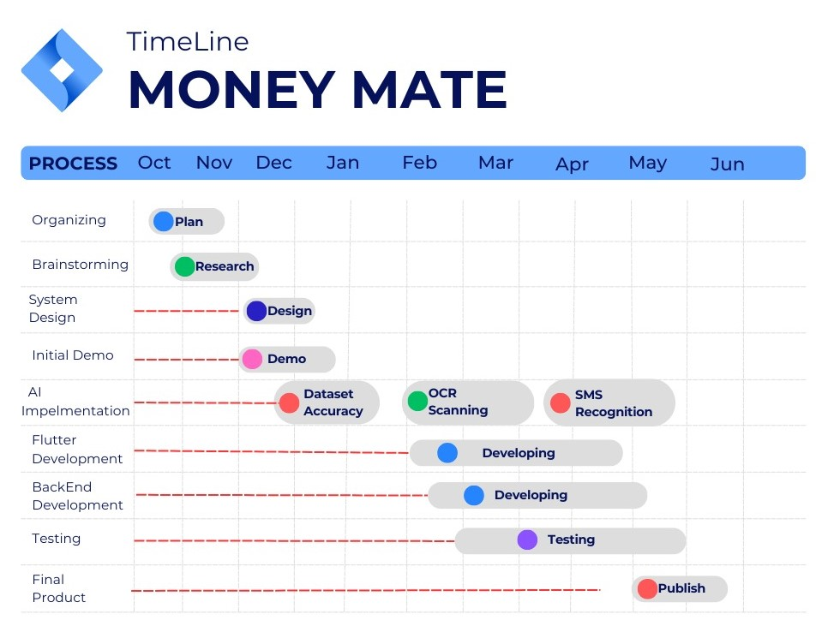
Project Timeline:

Slide 15
06
Artificial Intelligence

Slide 16
AI Features:
Main Features:
• Sms auto recognition.
• OCR receipt scanning.

Slide 17
Sms auto recognition:
Key Features:
• Reads SMS inbox using another_telephony package.
• Filters messages from trusted bank senders.
• Extracts amounts using a smart RegEx.
• Logs all actions using custom logger.
• Stores transactions with amount, date, sender, and body.

Slide 18
Sms auto recognition:
Process Flow:
1- Fetch all SMS from inbox.
2- Filter by bank senders (60+ listed).
3- Extract amount using RegEx.
4- Log & store valid transactions.

Slide 19
OCR receipt scanning:
Build a privacy-first using ML kit, smart receipt analyzer to automatically extract key info:
• Total Amount.
• Currency.
• Purchase Date.
All done locally on the device — no cloud, no data leaks.

Slide 20
OCR receipt scanning:
Why Local? (Security First!)
• All processing happens offline.
• No receipt image or text is sent to any server.
• Prevents risks of data exposure, especially for sensitive purchases.
• Ensures user trust.

Slide 21
OCR receipt scanning:
Key Extraction Techniques:
• Total Amount + Currency:
• Keyword matching:
"total", "grand total", "balance due", etc.
• Smart line scanning:
Looks at line with keyword + next 3 lines.
• Uses RegEx to detect patterns like:
58.75 EGP, 1,200.00 USD, etc.

Slide 22
OCR receipt scanning:
Key Extraction Techniques:
• Date Detection:
• Supports flexible formats:
"dd/MM/yyyy", "yyyy-MM-dd", "MM.dd.yy", etc.
• Selects closest past date from today.
• Uses Dart’s intl.DateFormat for formatting.
• Filters out future dates or invalid patterns.

Slide 23
07
System Design

Slide 24
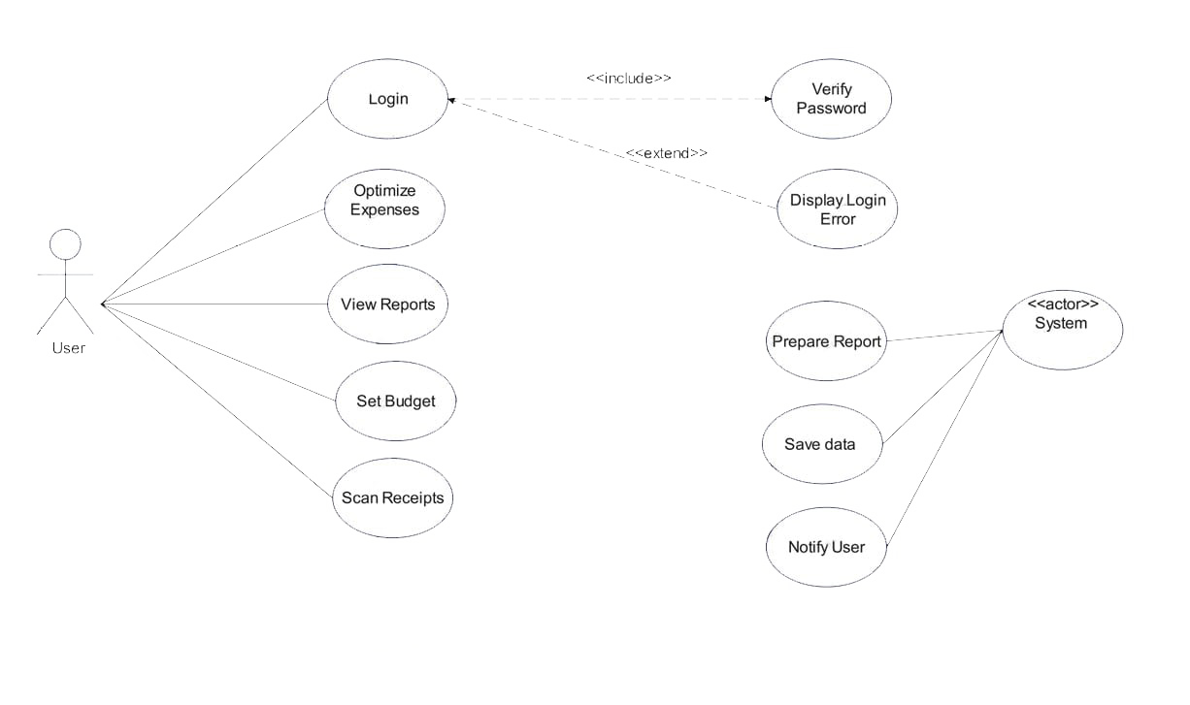
Use case diagram:

Slide 25
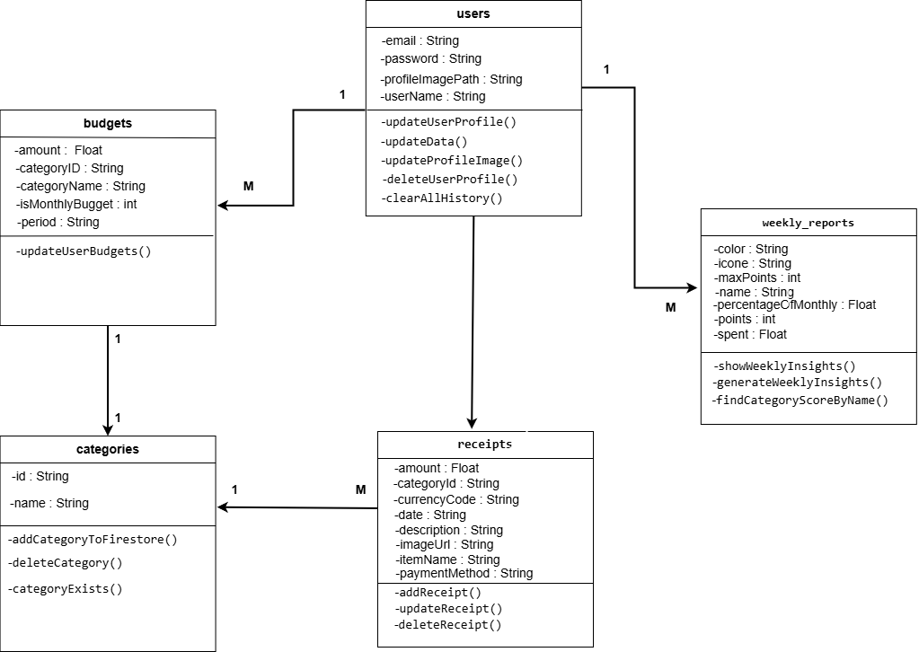
Class diagram:

Slide 26
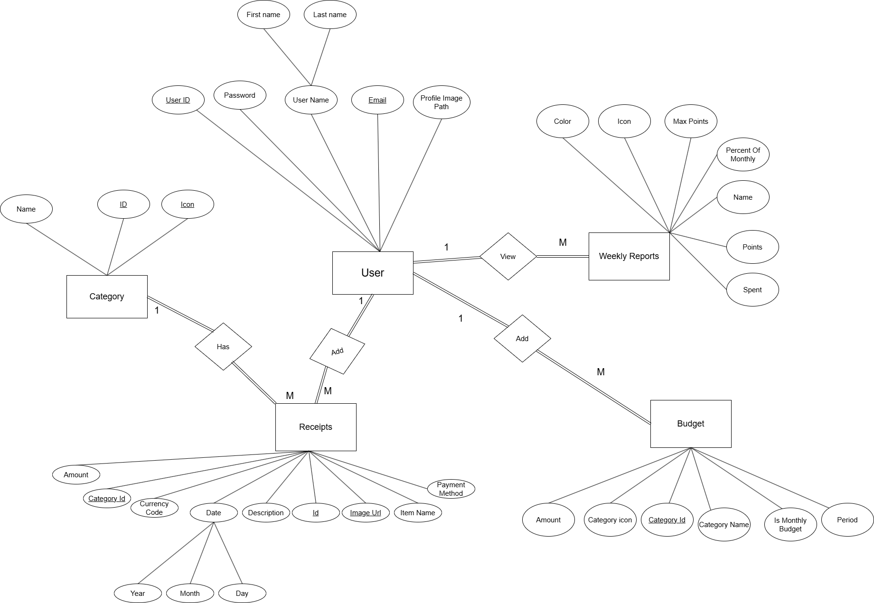
ERD diagram:

Slide 27
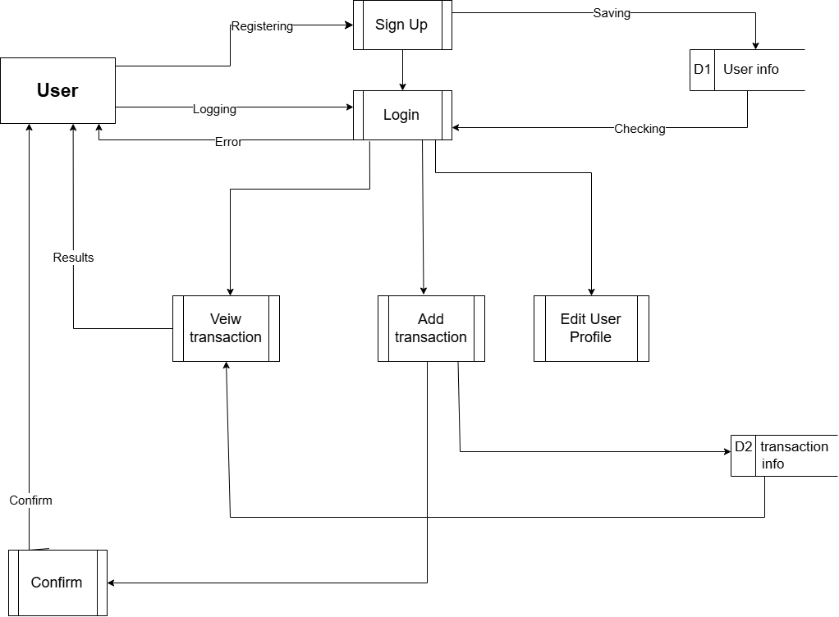
Data flow diagram:

Slide 28
08
BACKEND

Slide 29
Why Firebase Powers MoneyMate:
• Real-time Data Sync:
Firebase Realtime Database and Firestore sync data instantly across all devices.
• Cloud Functions:
Run backend code in response to events like new user signups or data updates.

Slide 30
Why Firebase Powers MoneyMate:
• Secure & Scalable:
Firebase security rules protect user data.
Scales easily from small apps to millions of users.
• Crash Reporting:
Firebase Crashlytics gives real-time crash reports with detailed logs.

Slide 31
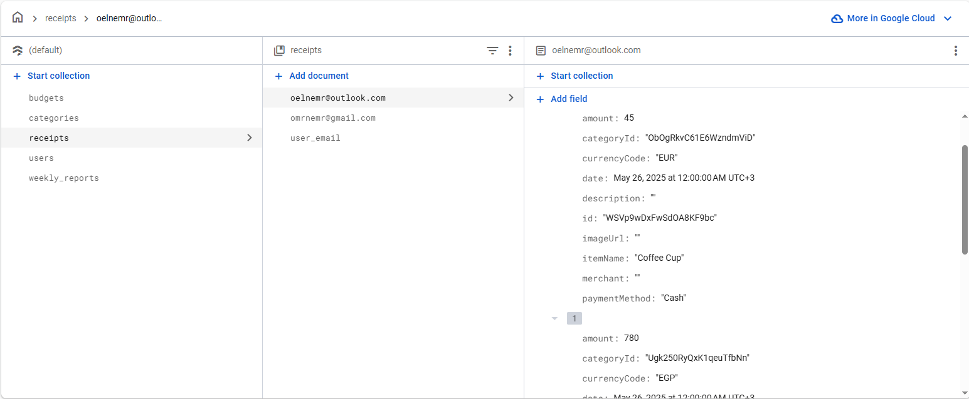
Database Schema:

Slide 32
09
FRONTEND

Slide 33

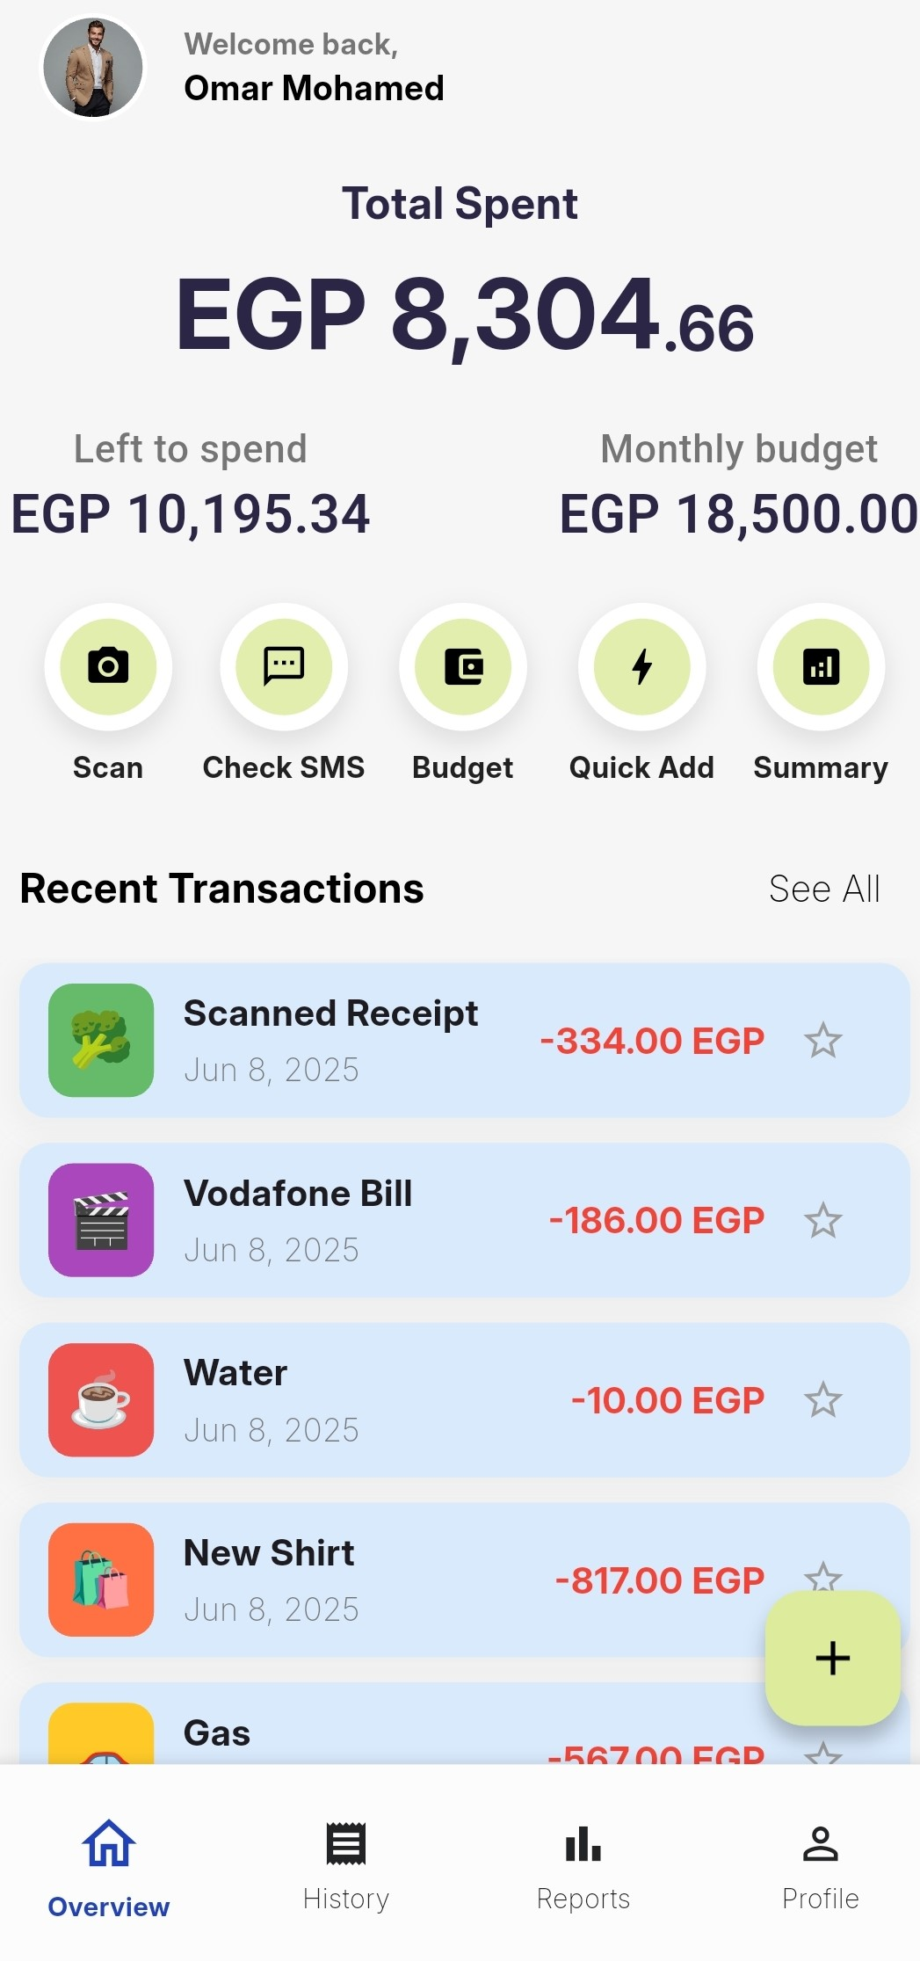
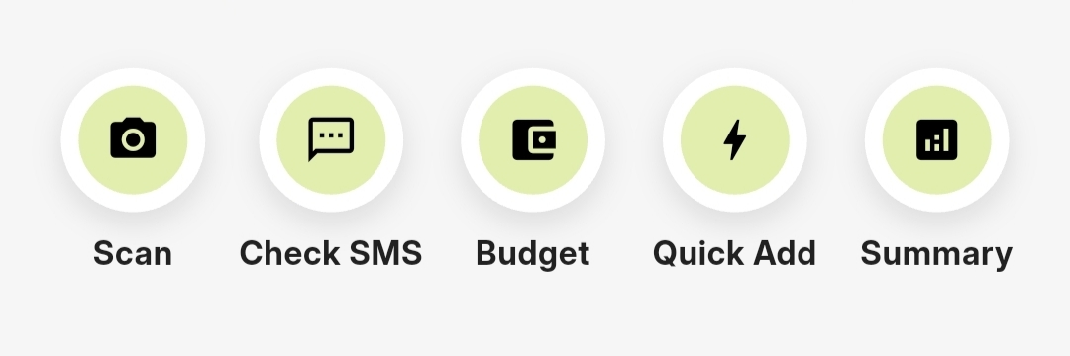
Simple, intuitive,
user-friendly, efficient

Slide 34
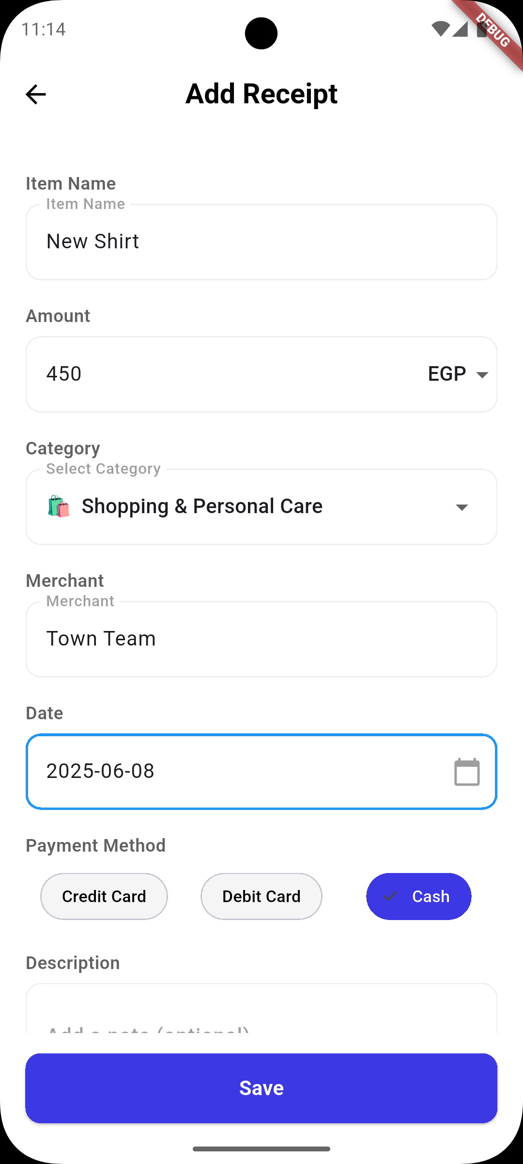
Every expense counts, Add it Manually.

Slide 35
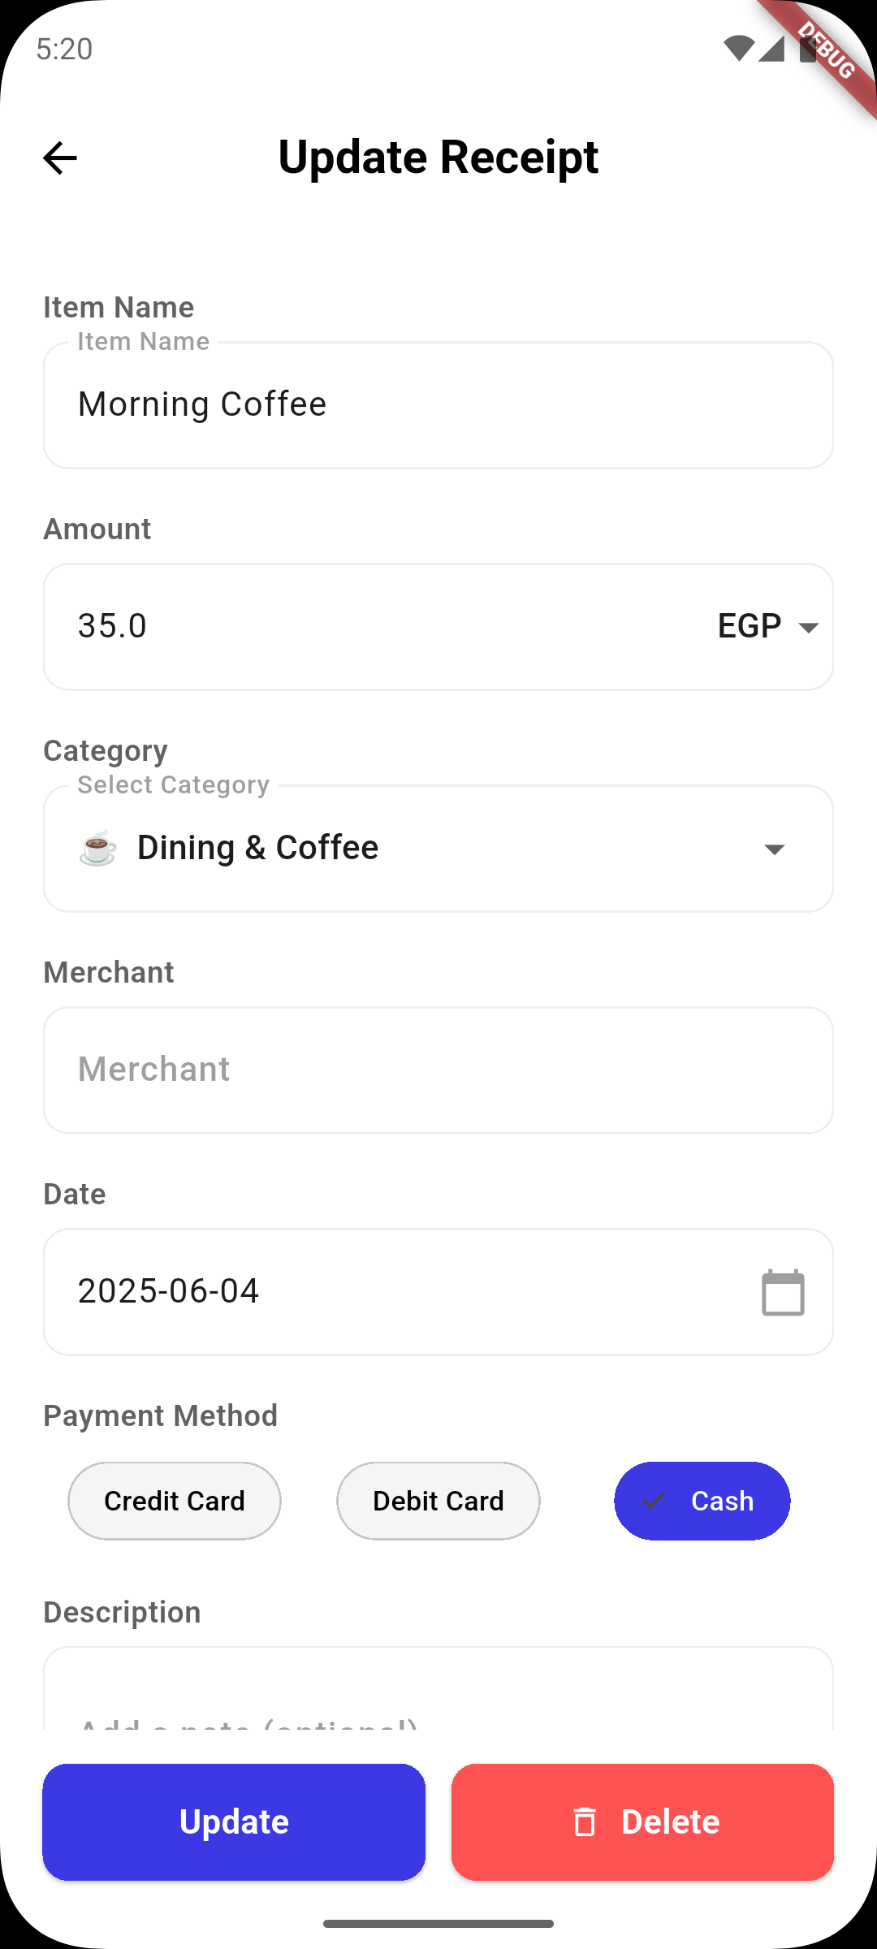
Easily Edit and Update Your Receipts for Accurate Tracking

Slide 36
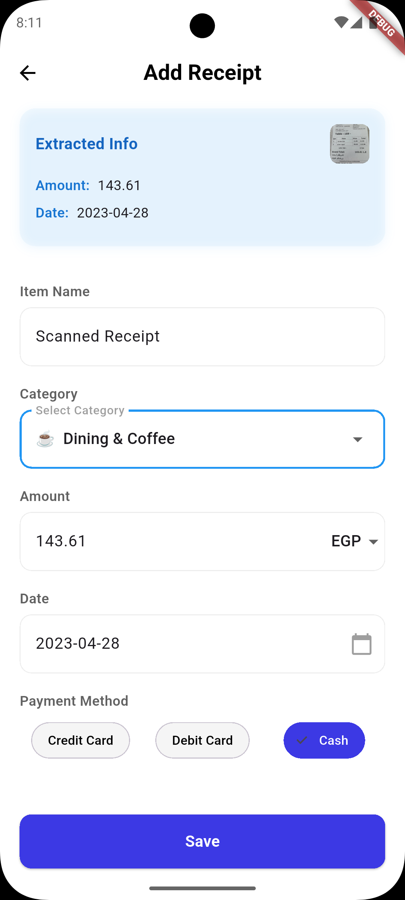
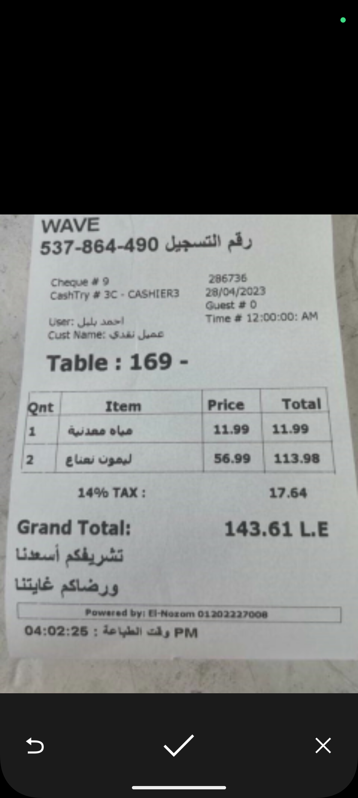
Quick OCR scanning

Slide 37
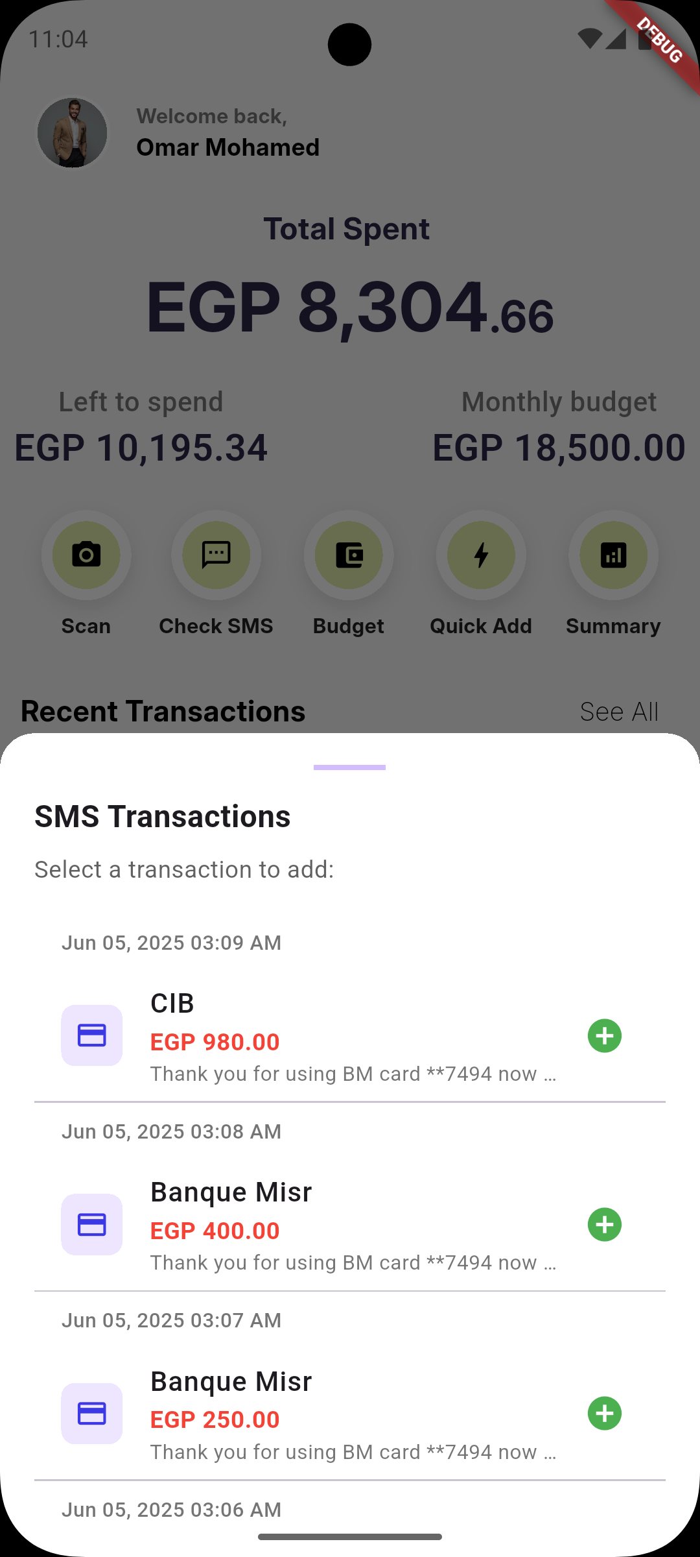
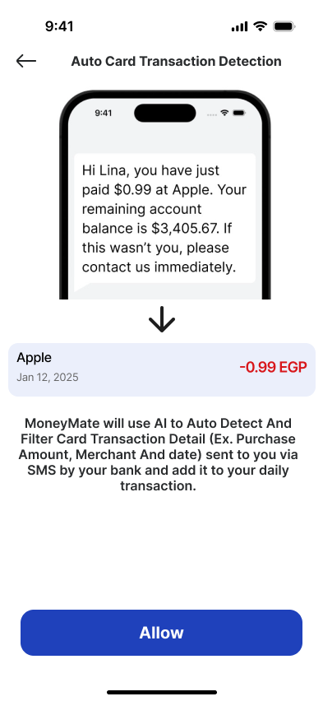
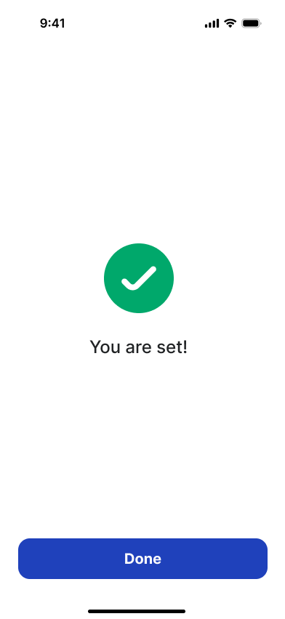
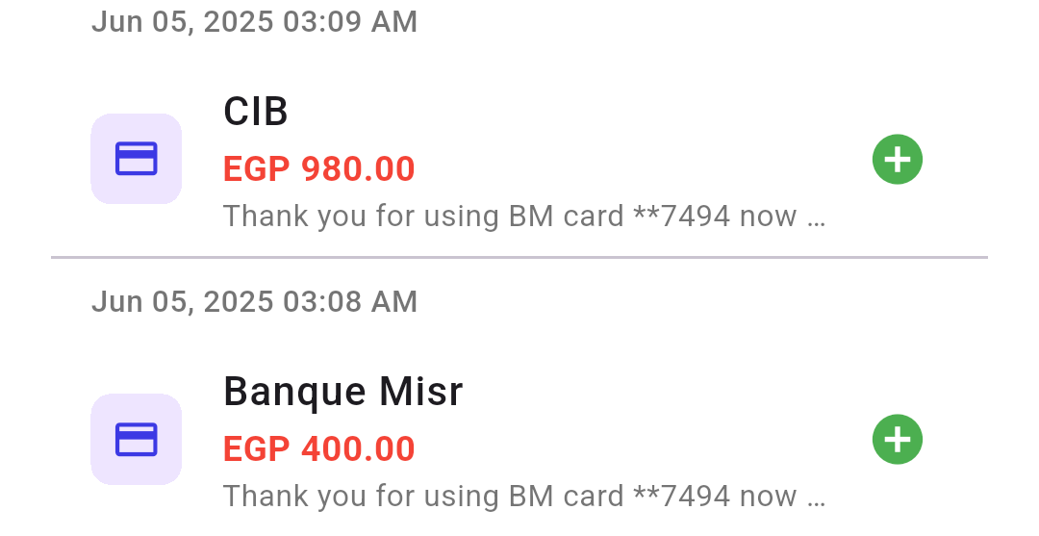
SMS recognition

Slide 38
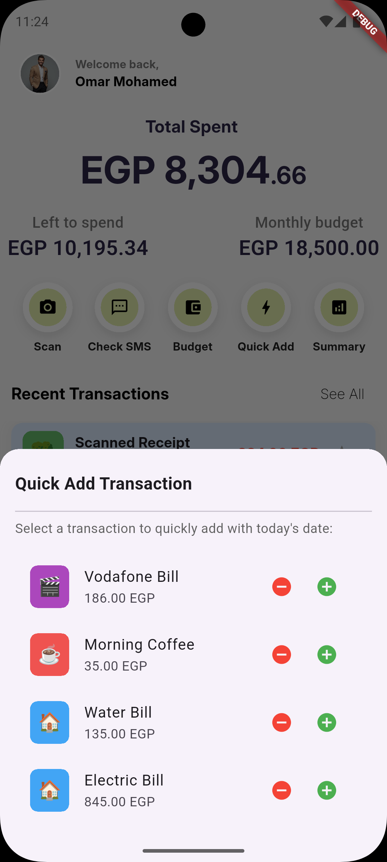
Quick Add keeps it light and fast.

Slide 39
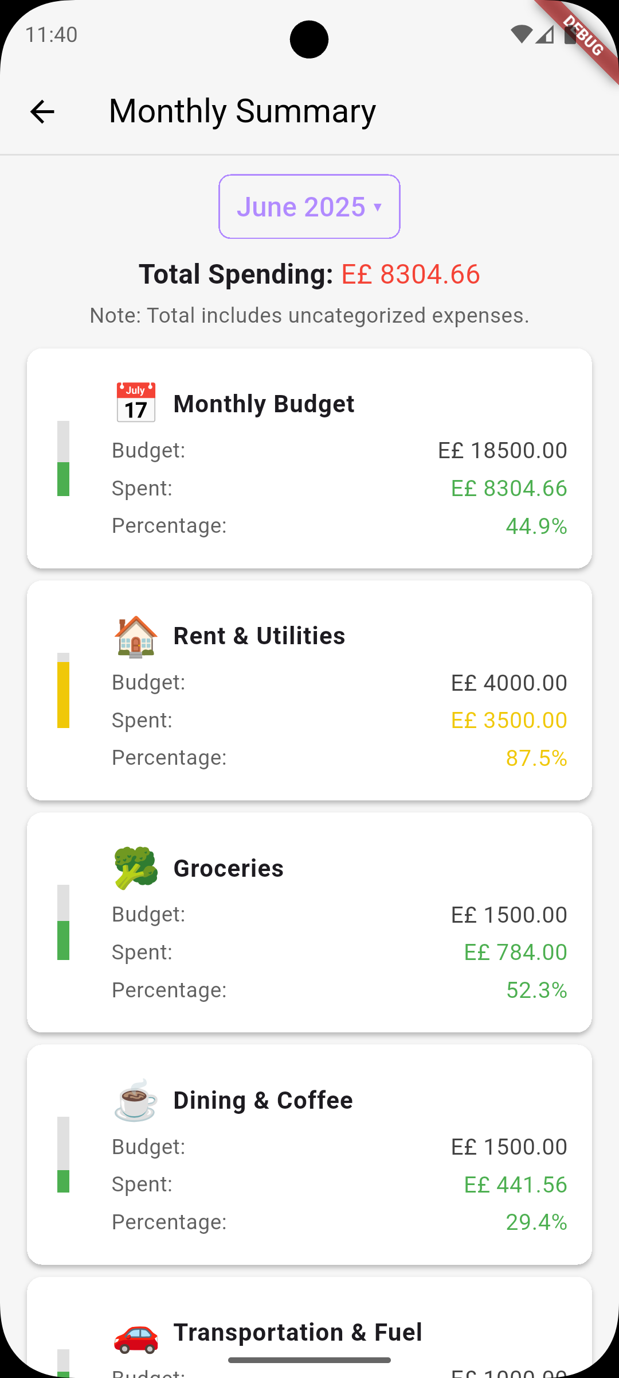
Monthly Summary, Track spending trends and stay in control.

Slide 40
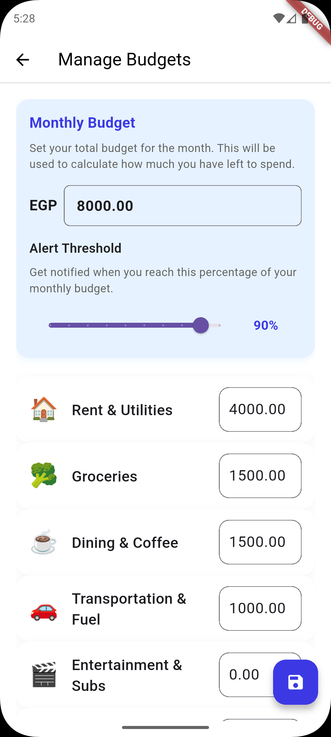
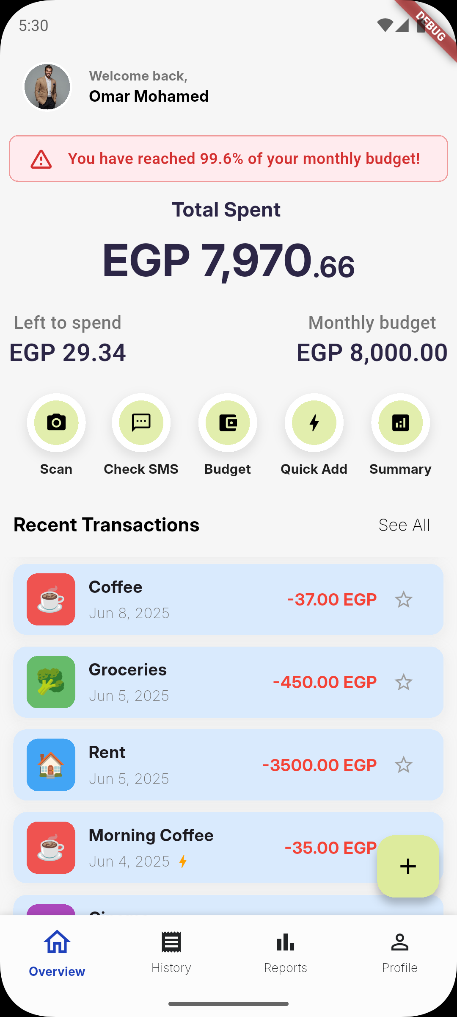

Never Miss a Limit — Get Budget Notifications

Slide 41
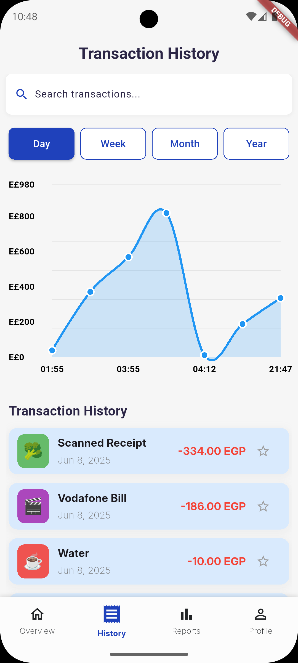
Track the Past, Budget the Future

Slide 42
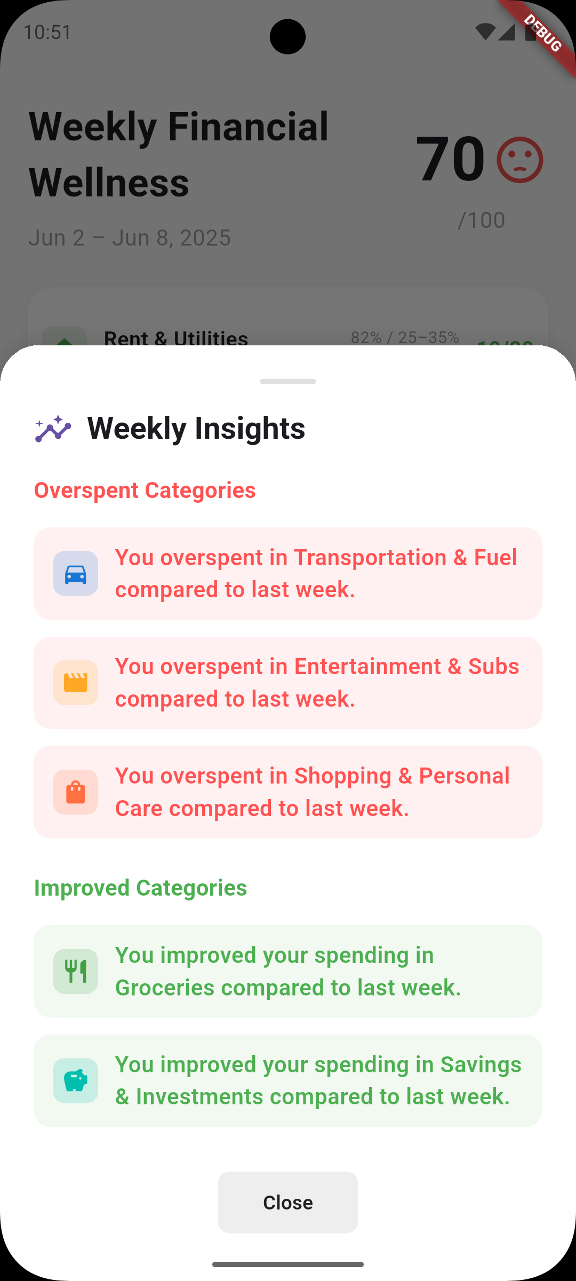
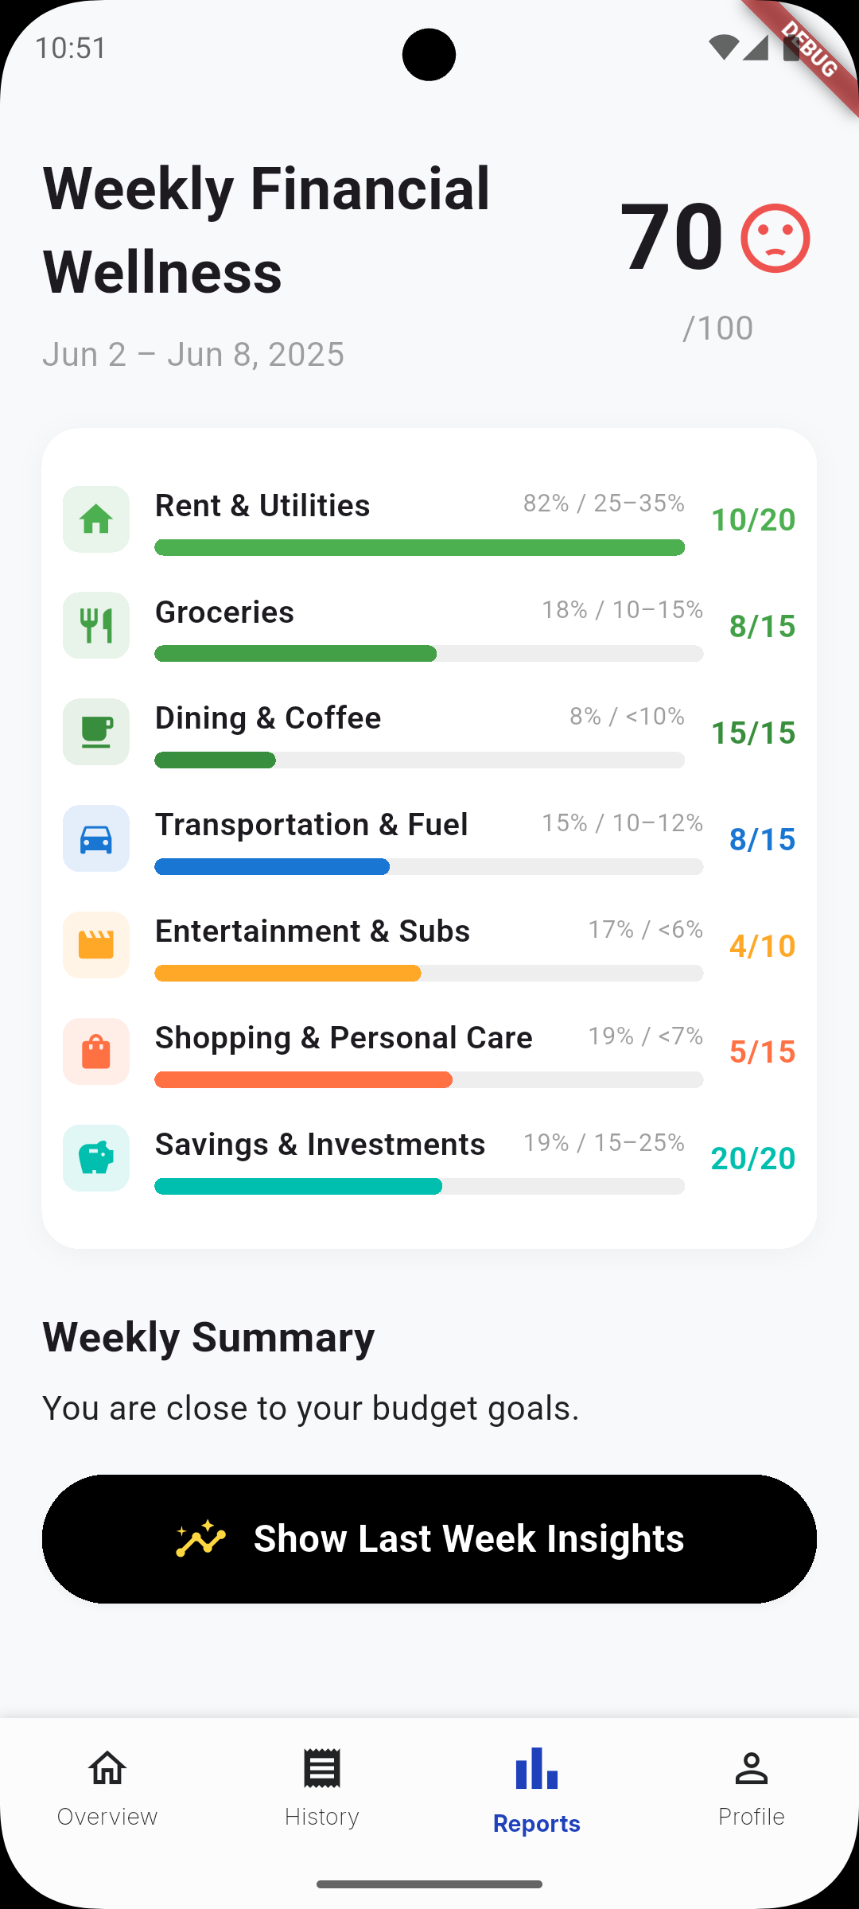

From Daily Details to Weekly Insights—Weekly Financial wellness

Slide 43
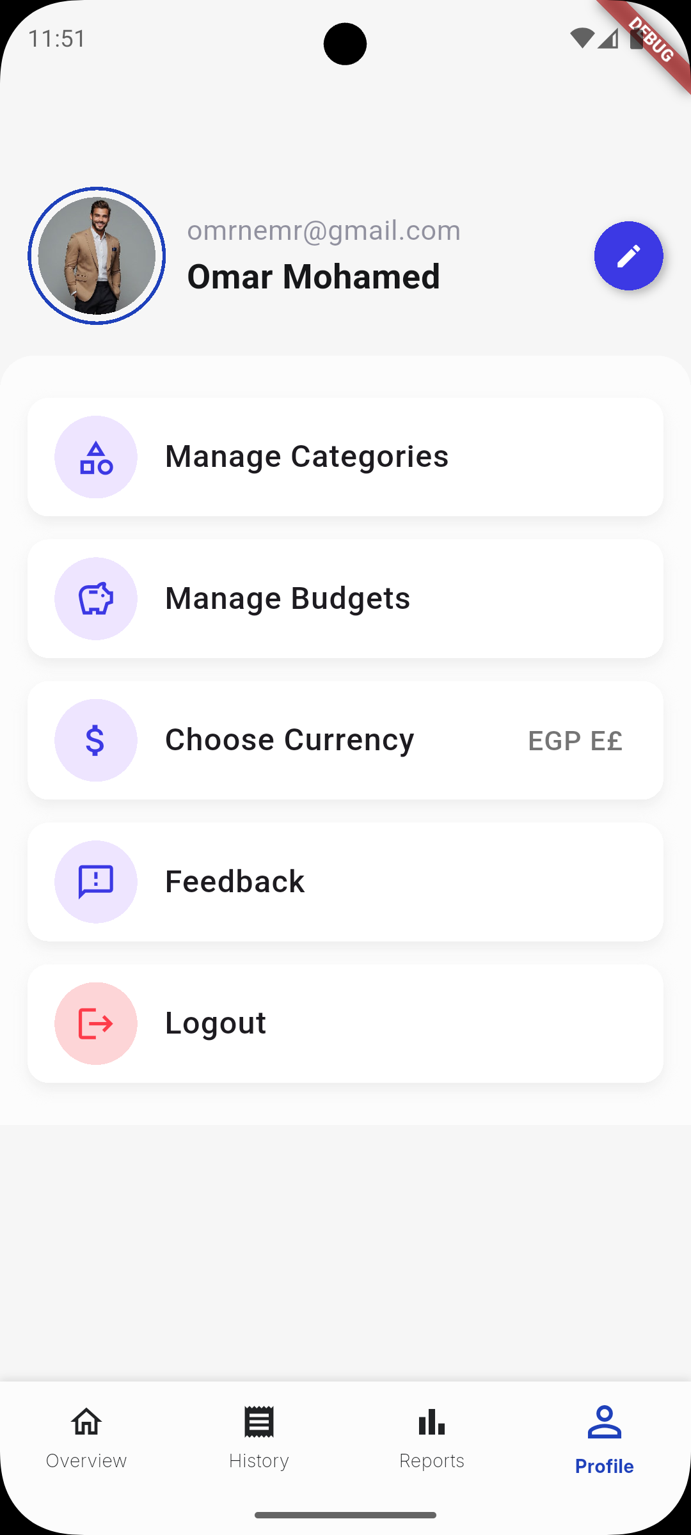
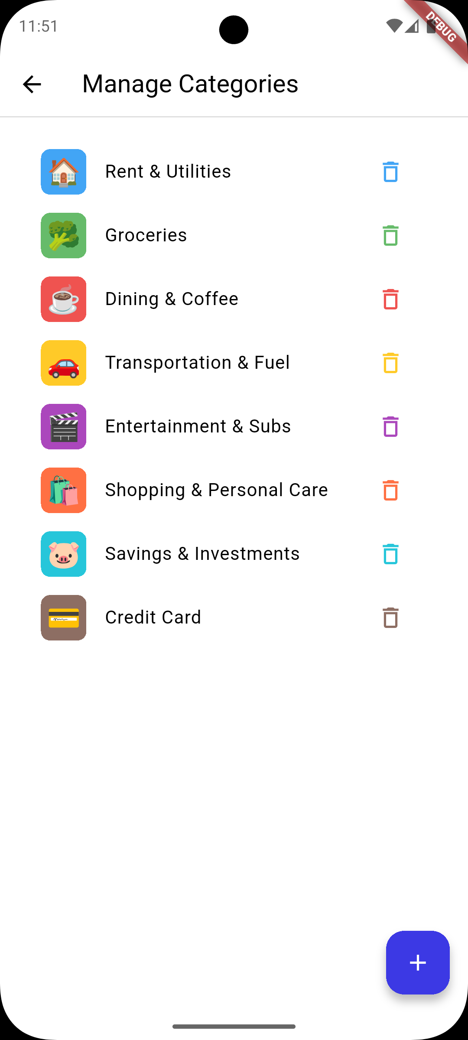
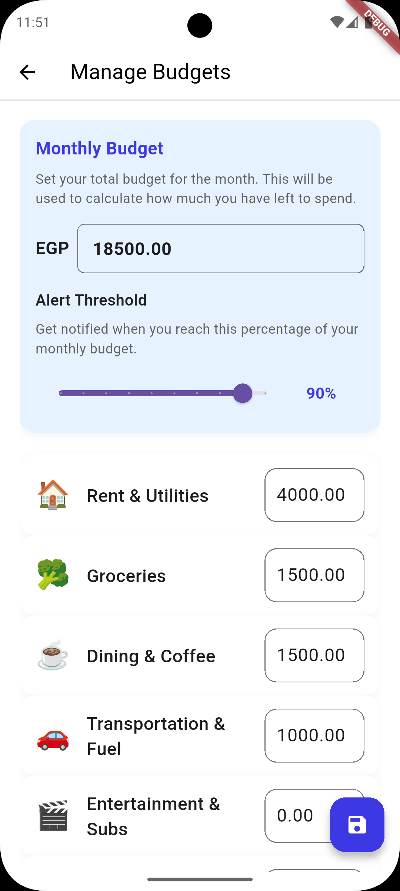
Customize your categories and set budgets to take full control.

Slide 44
10
DEMO

Slide 45
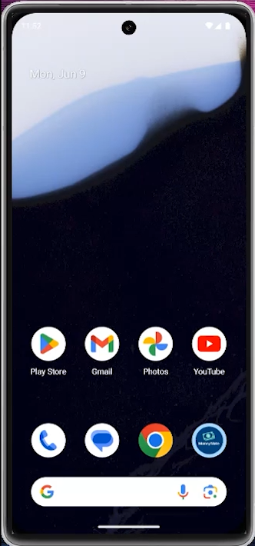

Slide 46
Thank you

